Slide 1

SEMINAR PRESENTATION
ON
GAME DATA ANALYTIC USING DESCRIPTIVE AND PREDICTIVE MINING
BY
PRITI SANTOSH MAURYA
MC21954
POST GRADUATE DEPARTMENT OF COMPUTER SCIENCE,
S.N.D.T. WOMEN’S UNIVERSITY
MASTER OF COMPUTER APPLICATION
SEM VI - (2020 – 2021)

Slide 2
Index
1. Introduction
2. Data
3. Operating Environment – Hardware and Software
4. Data Mining Techniques – Descriptive
5. Data Mining Techniques – Predictive
6. Conclusion

Slide 3
Introduction
A video game is an electronic game that can be played on a computing device, such as a personal computer, gaming console or mobile phone.
Depending on the platform, video games can be subcategorized into computer games (for personal computer )and console games(need some remote or other device to play).
Example : console game gta5, spider man, Minecraft.
pc game (sonic, super mario)
In recent years however, the emergence of social networks, smartphones and tablets introduced new categories such as mobile and social games.
Video games have come a long way since the first games emerged in the 1970s.
Today's video games offer photorealistic graphics and simulate reality to a degree which is astonishing in many cases.

Slide 4
Data
https://www.kaggle.com/chuyachia/video-games-sales-prediction - “Data Set”.
1. Name: Name of the game
2. Platform: Console on which the game is running
3. Year_of_Release: Year of the game released
4. Genre: Game’s category
5. Publisher: Publisher
6. NA_Sales: Game sales in North America
7. EU_Sales: Game sales in the European Union
8. JP_Sales: Game sales in Japan (in millions of units)
9. Other_Sales: Game sales in the rest of the world, i.e. Africa, Asia excluding japan, Australia, Europe excluding the E.U. and South America (in millions of units)

Slide 5
10. Global_Sales: Total sales in the world (in millions of units)
11. Critic_Score: Aggregate score compiled by Meta critic staff
12. Critic_Count: The number of critics used in coming up with the Critic_score (Professional critic count review is known as critic_count )
13. User_Score: Score by Metacritic’s subscribers
14. User_Count: Number of users who gave the user_score
15. Developer: Party responsible for creating the game
16. Rating: The ESRB ratings: E for “Everyone”; E10+ for “Everyone 10+”; T for “Teen”; M for “Mature”; AO for “Adults Only”; RP for “Rating Pending”; K-A for kids to adults

Slide 6
Operating Environment – Hardware and Software
Hardware
Intel core i3 7Th generation is used as a processor.
Ram 1gb is used as it will provide fast reading and writing capabilities and will in turn support in processing
Software
Rstudio
Operating system- Windows 10 is used as the operating system as it is stable and supports more features and is more user friendly

Slide 7
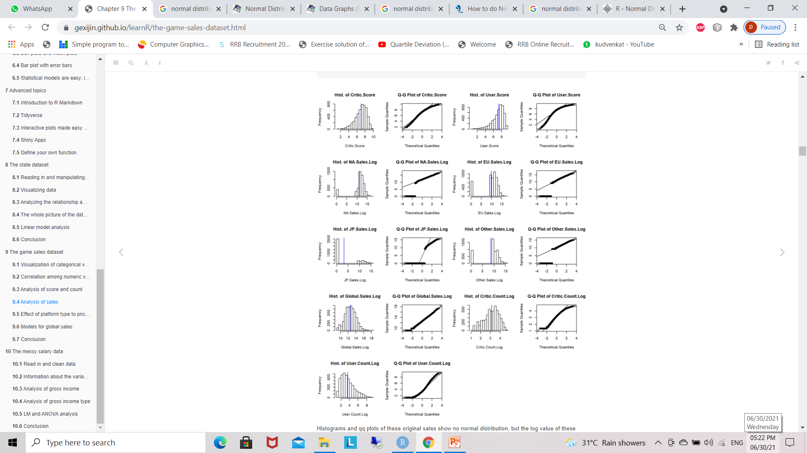
Quantile Quantile-Plot(Histogram)

Slide 8
Histograms and qq plots of these original sales show no normal distribution, but the log value of these sales are much close to normally distributed, especially the log value of global sales.
Though the Shapiro test with p value lass than 0.05 deny its normality, it’s much better than the other sales or other log values of sales.
Maybe the missing value of sale is the reason of abnormality.
From the histograms and qq plots we also see that two scores and log values of their counts are close to normal distribution.

Slide 9
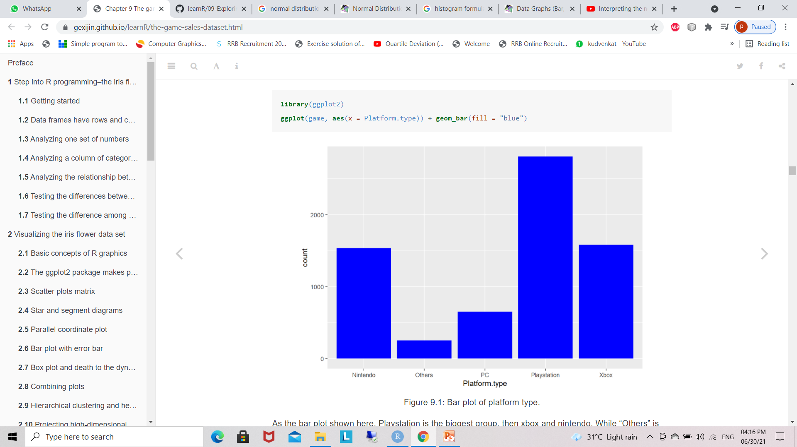
Visualization of categorical variables
Regroup platform as Platform.type
Bar graph
regroup Rating as Rating.type
rename the names of counts for detail information
According to the order, the most popular ratings are T, E, M and E10+. “Others” rating only occupy very little portion in the all games.

Slide 10
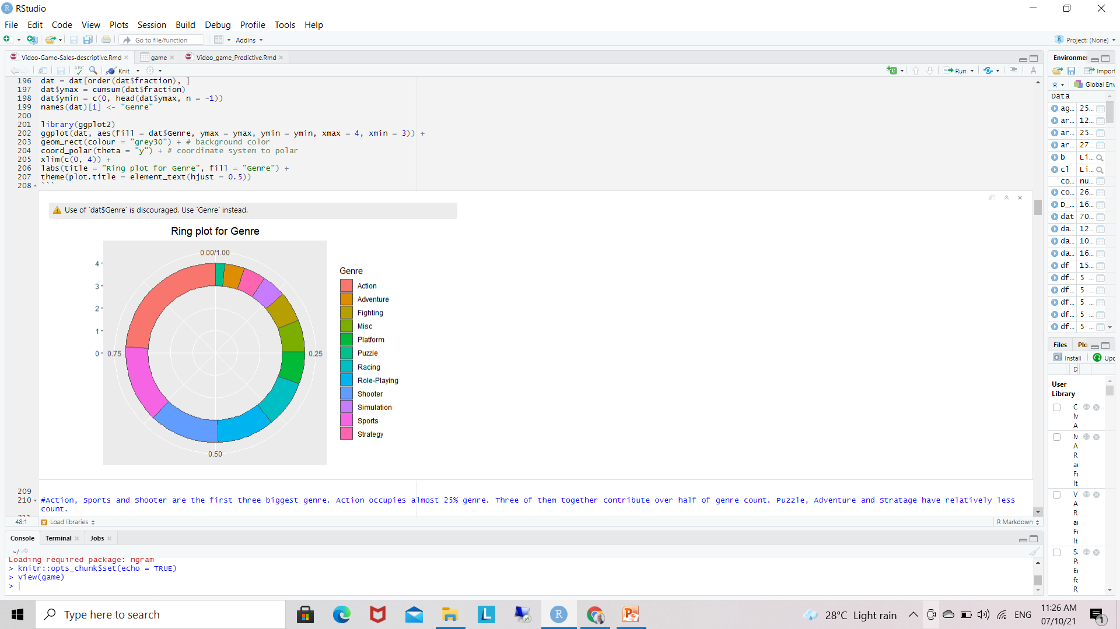
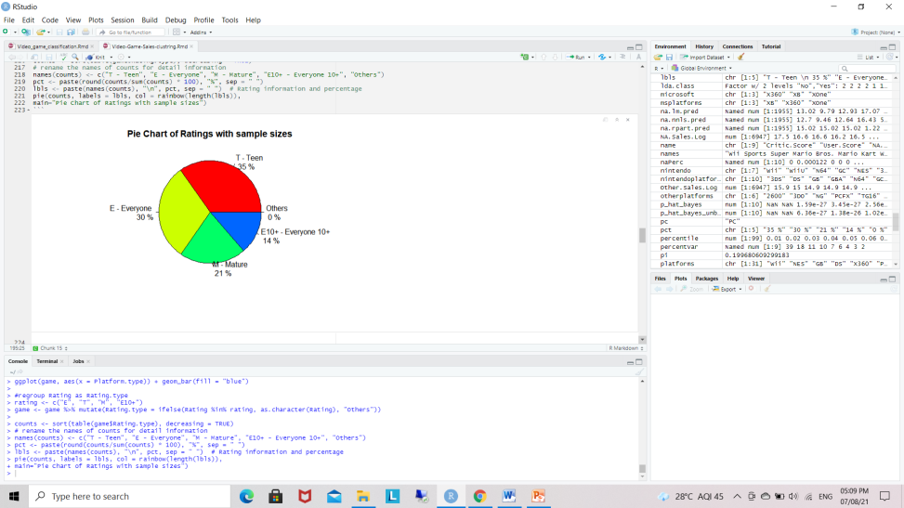
Ring plot and Pie chart
Ring Plot
Pie chart

Slide 11
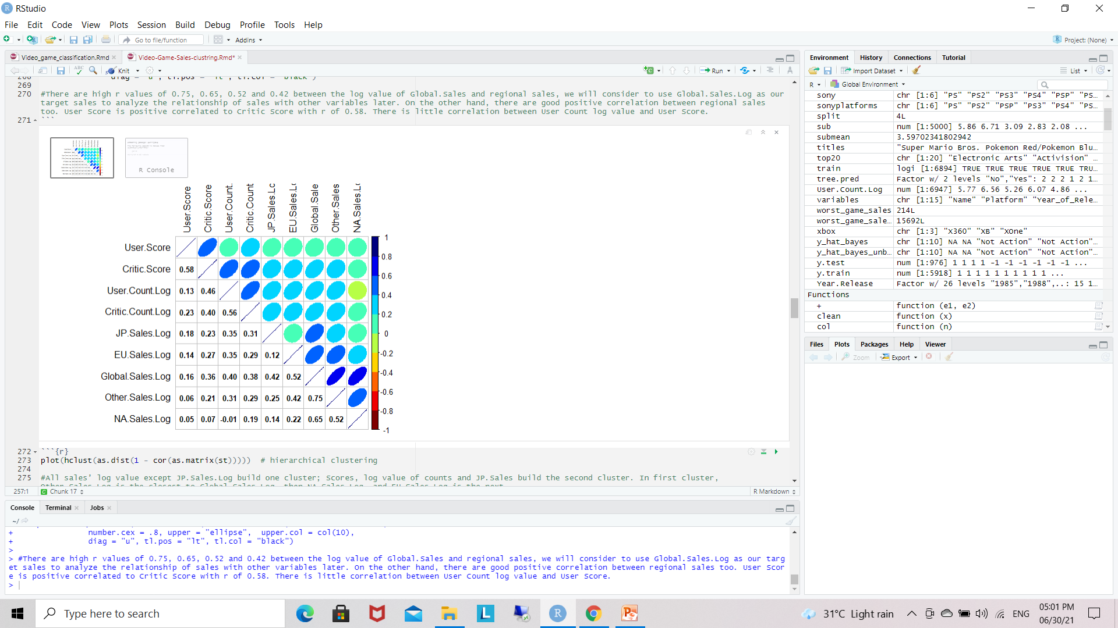
2. Correlation among numeric variables
Take numeric variables as goal matrix
Correlation matrix
There are high r values of 0.75, 0.65, 0.52 and 0.42 between the log value of Global.Sales and regional sales.
On the other hand, there are good positive correlation between regional sales too. User Score is positive correlated to Critic Score with r of 0.58. There is little correlation between User Count log value and User Score.

Slide 12
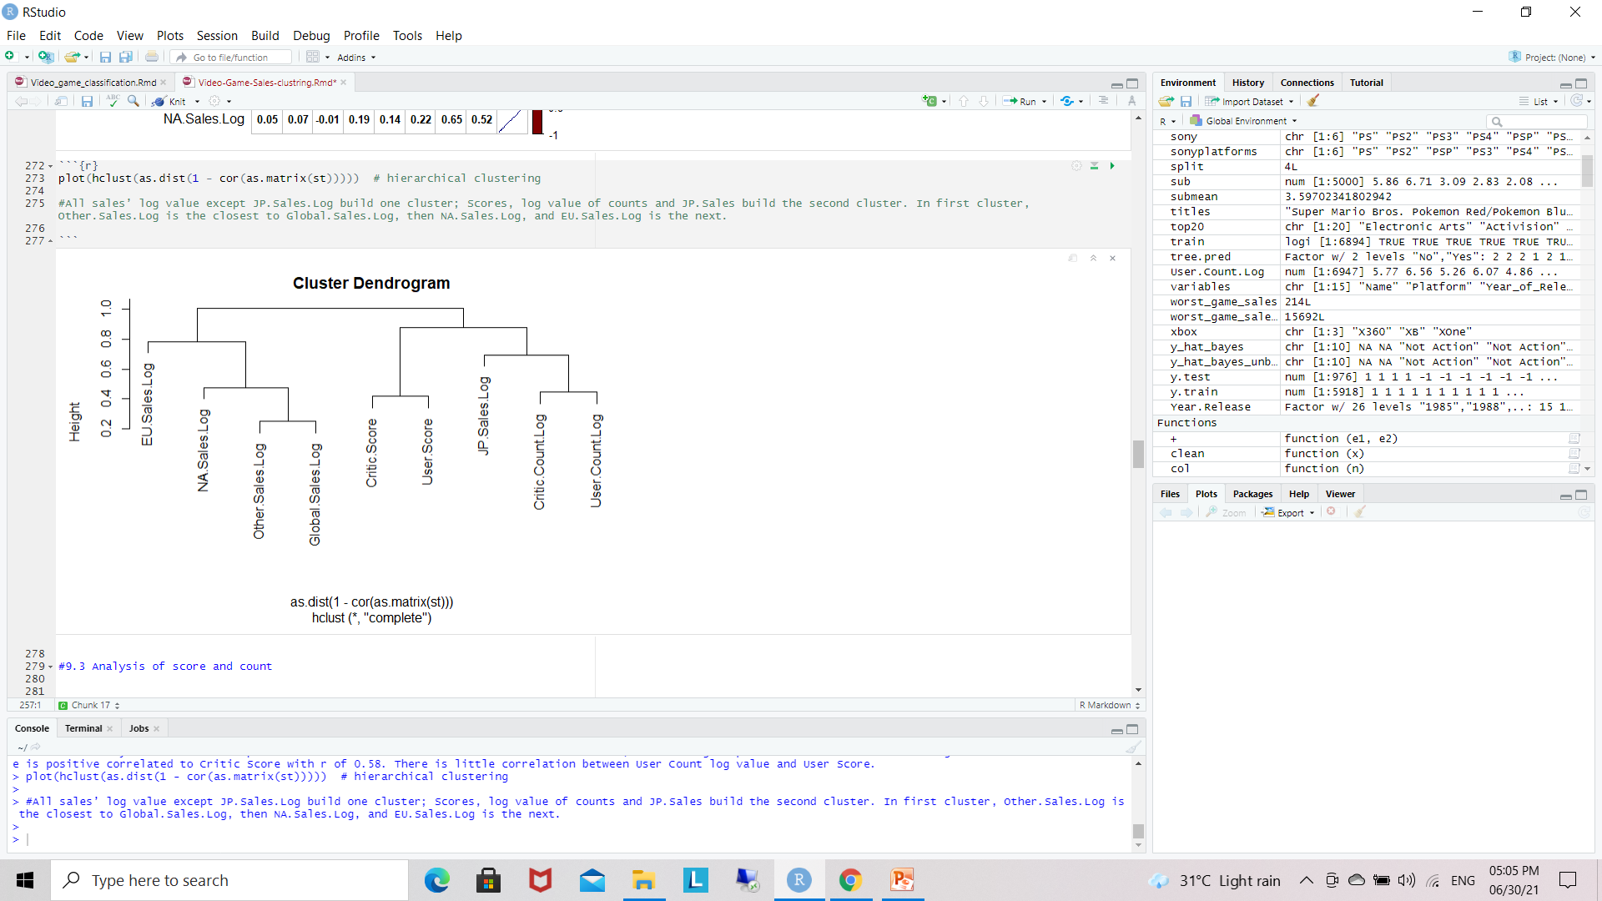
Cluster dendrogram for numeric variables.
plot(hclust(as.dist(1 - cor(as.matrix(st)))))
hierarchical clustering
All sales’ log value except JP.Sales.Log build one cluster; Scores, log value of counts and JP.Sales build the second cluster. In first cluster, Other.Sales.Log is the closest to Global.Sales.Log, then NA.Sales.Log, and EU.Sales.Log is the next

Slide 13
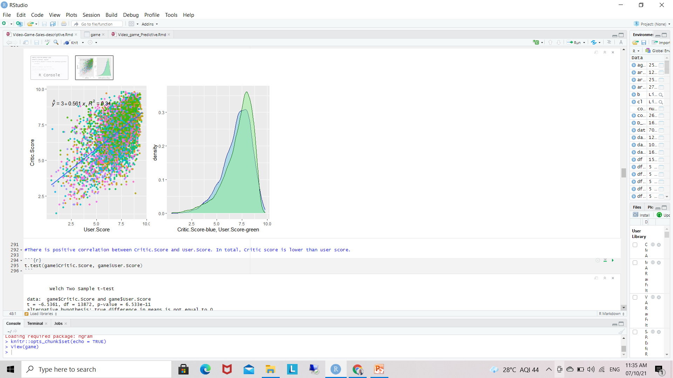
Analysis of score and count
Linear Regration
formula <- y ~ x
add regression line
add regression equation and R square value
output.type as "expression“

Slide 14
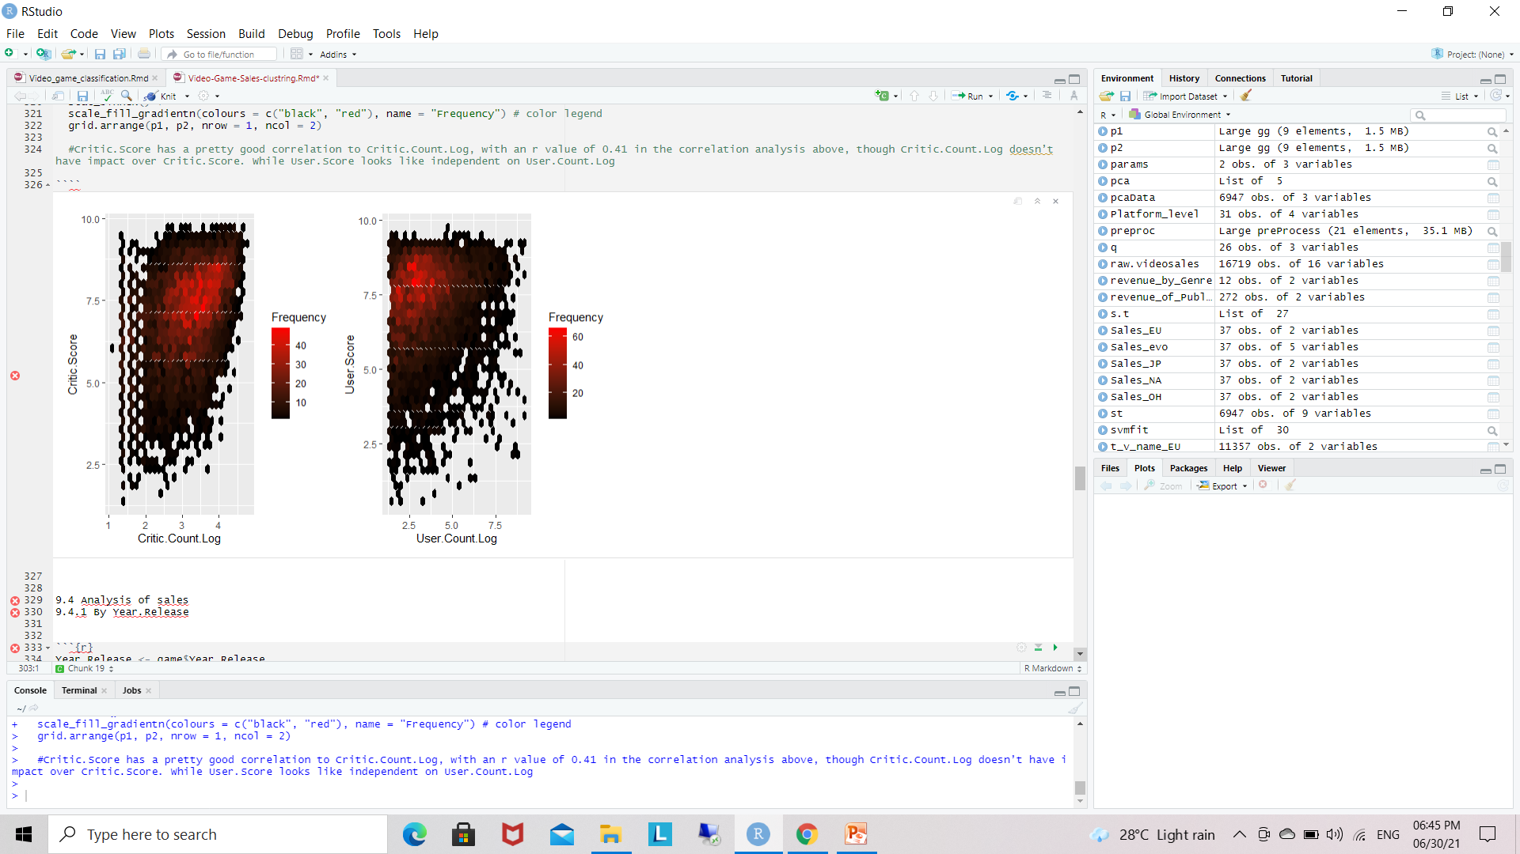
Correlation Analysis
Critic.Score has a pretty good correlation to Critic.Count.Log, with an r value of 0.41 in the correlation analysis above, though Critic.Count.Log doesn’t have impact over Critic.Score. While User.Score looks like independent on
User.Count.Log

Slide 15
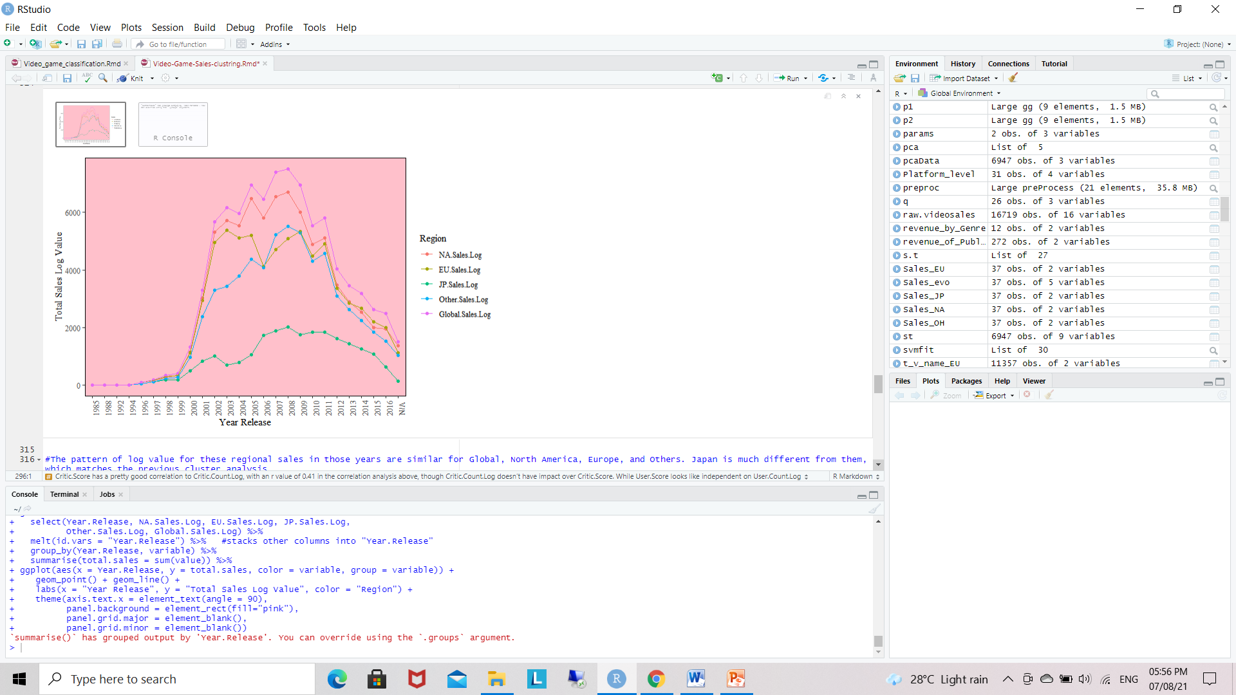
Analysis of sales - By Year.Release
The pattern of log value for these regional sales in those years are similar for Global, North America, Europe, and Others. Japan is much different from them.

Slide 16
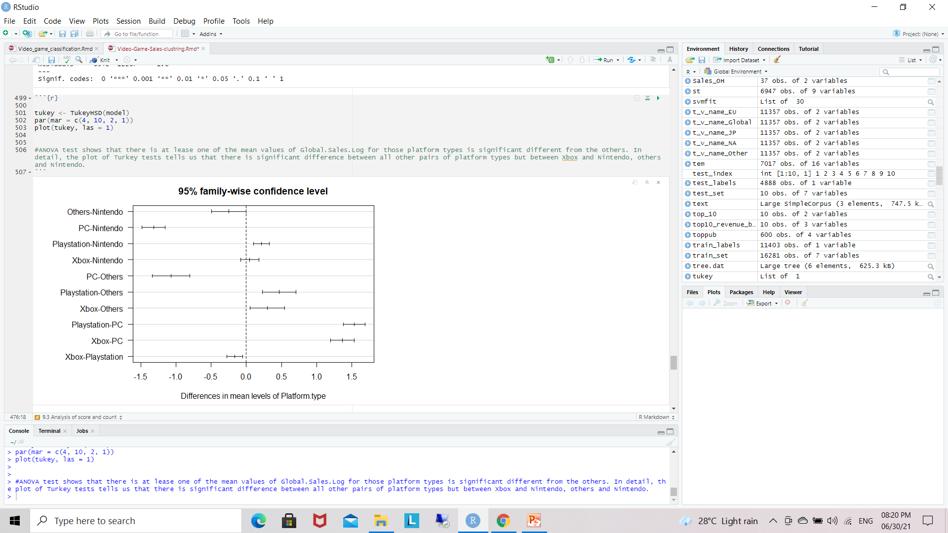
Anova
compute 1-way ANOVA test for log value of global sales by
Platform Type
ANOVA test shows that there is at lease one of the mean values of Global.Sales.Log for those platform types is significant different from the others. In detail, the plot of Turkey tests tells us that there is significant difference between all other pairs of platform types but between Xbox and Nintendo, others and Nintendo.

Slide 17
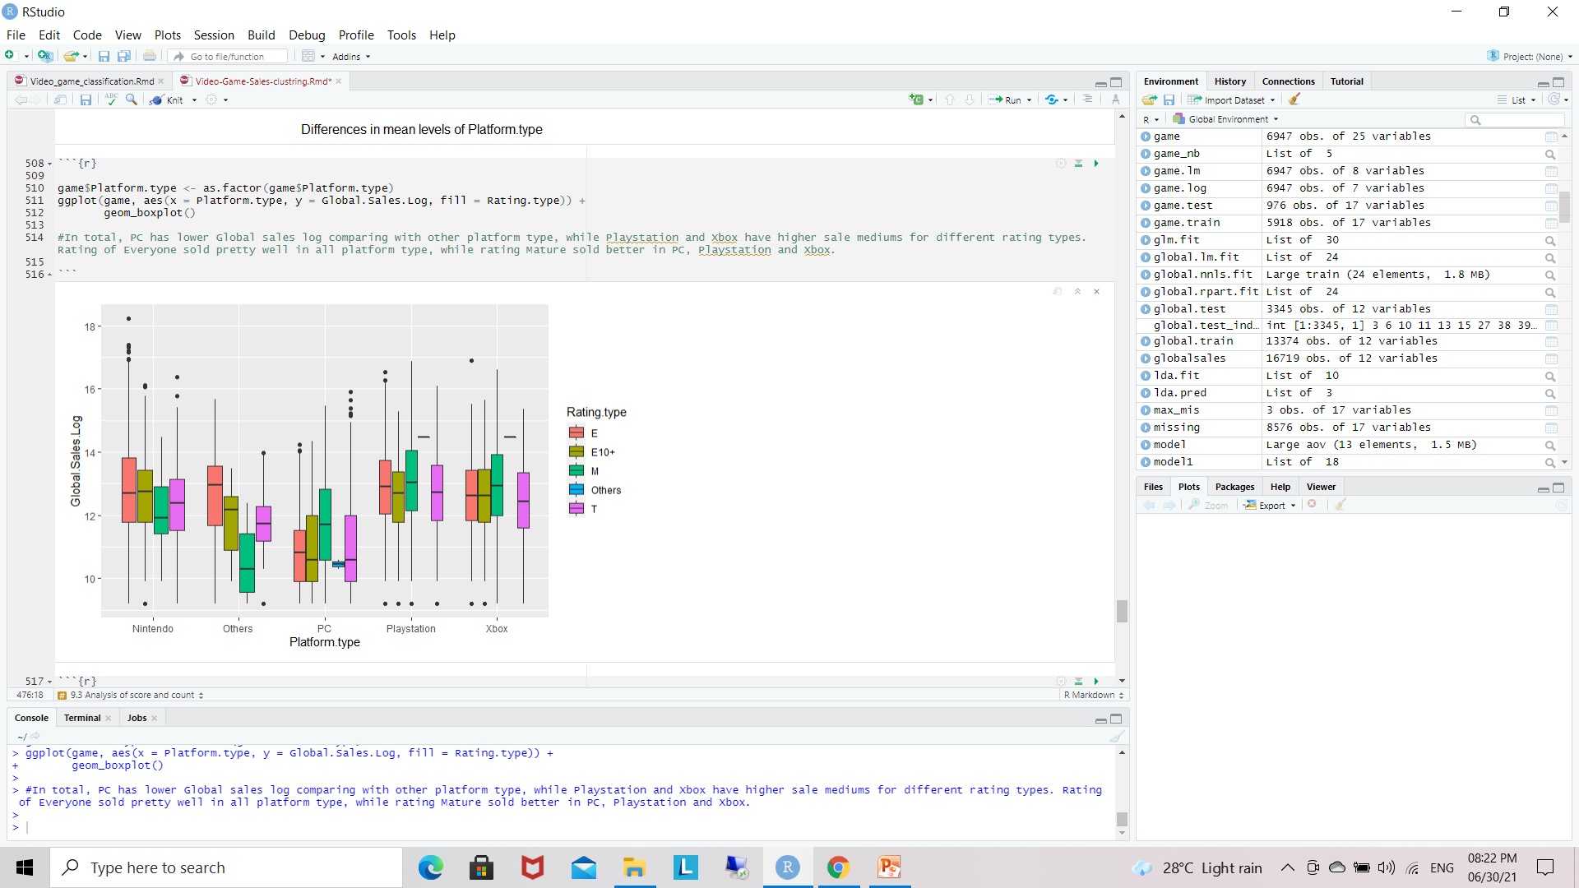
In total, PC has lower Global sales log comparing with other platform type, while PlayStation and Xbox have higher sale mediums for different rating types.

Slide 18
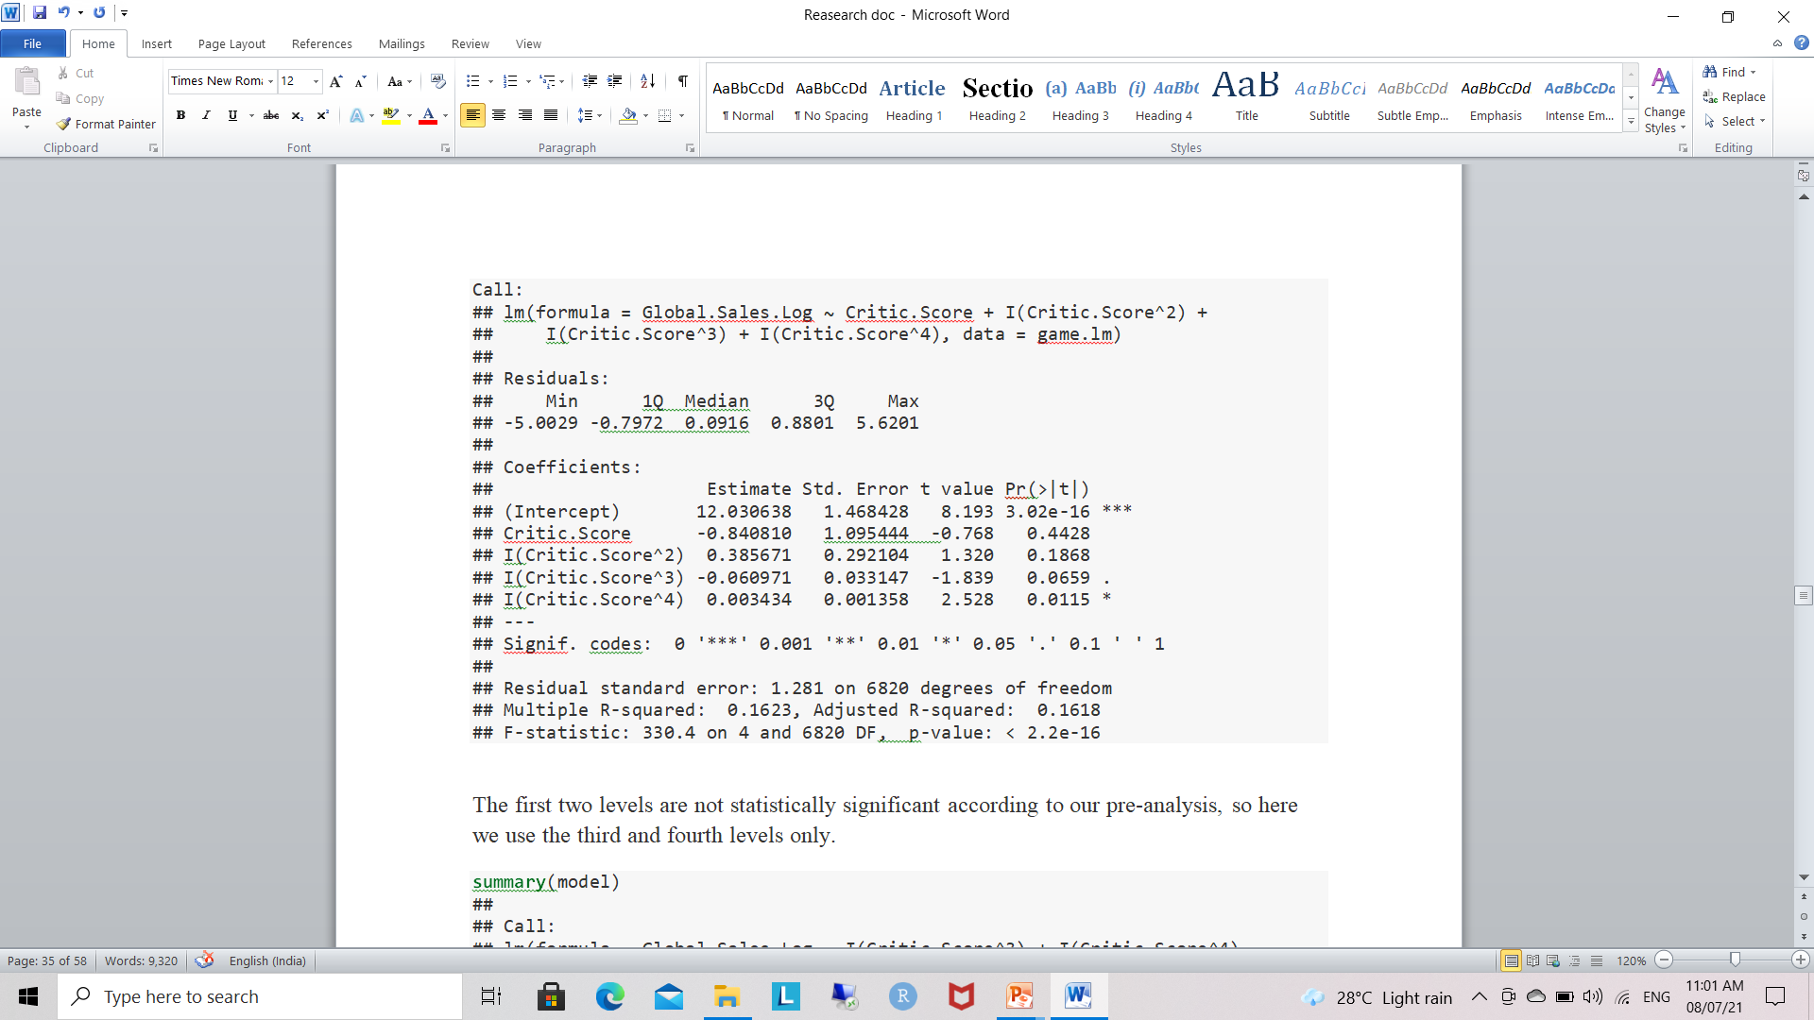
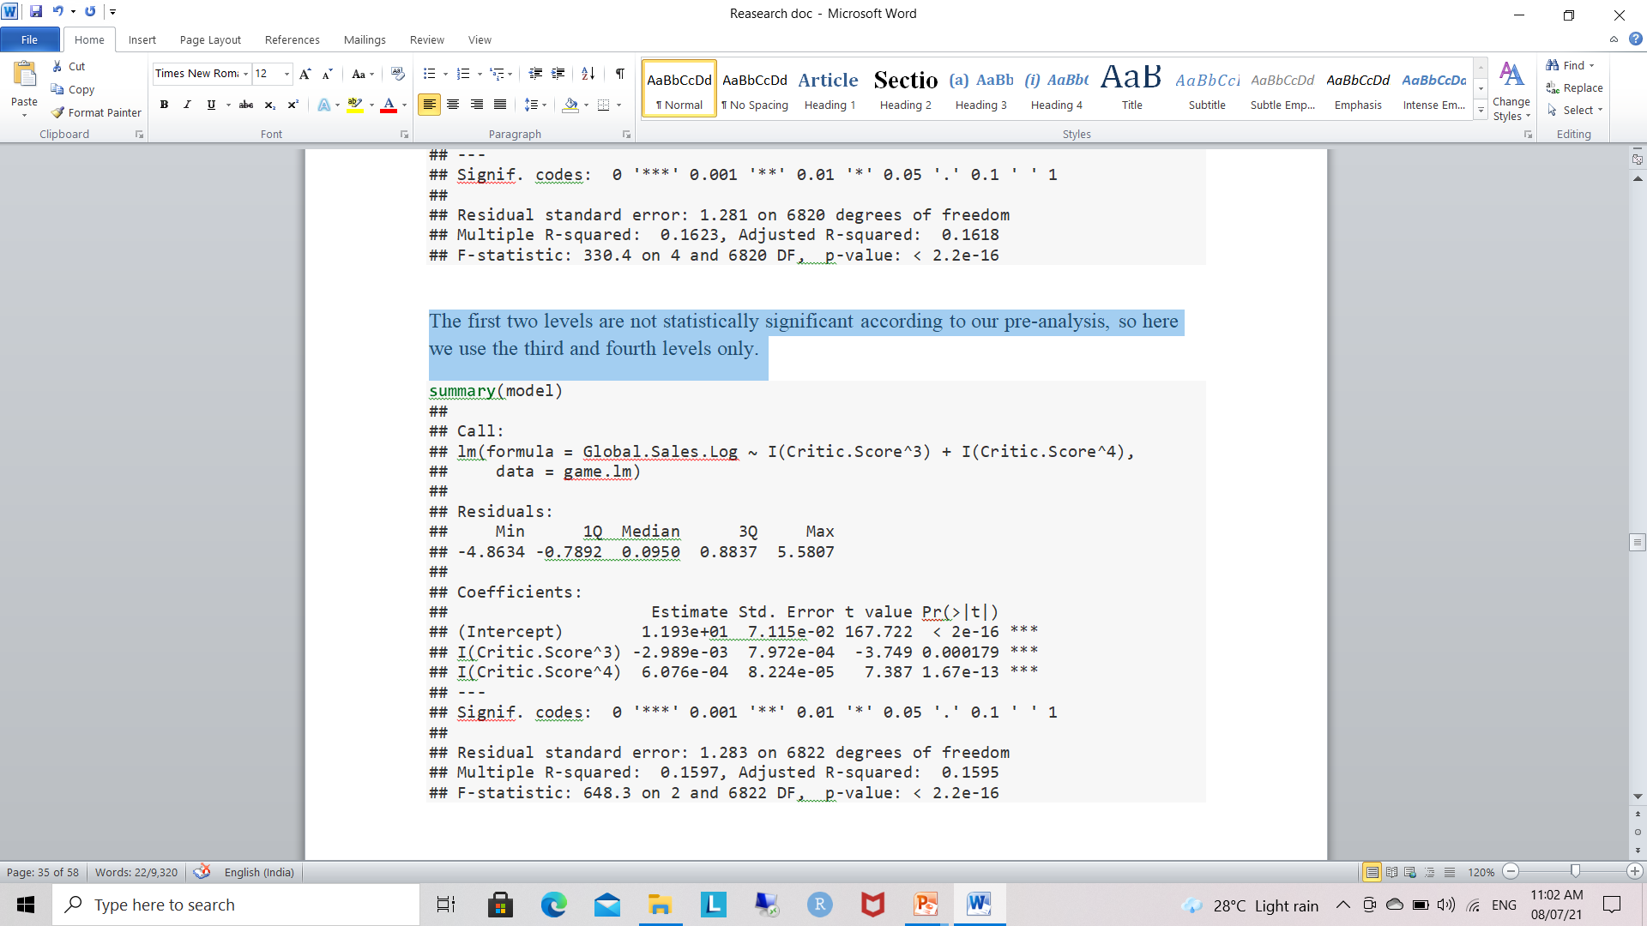
Multiple Regression
The first two levels are not statistically significant according to our pre-analysis, so here we use the third and fourth levels only.

Slide 19
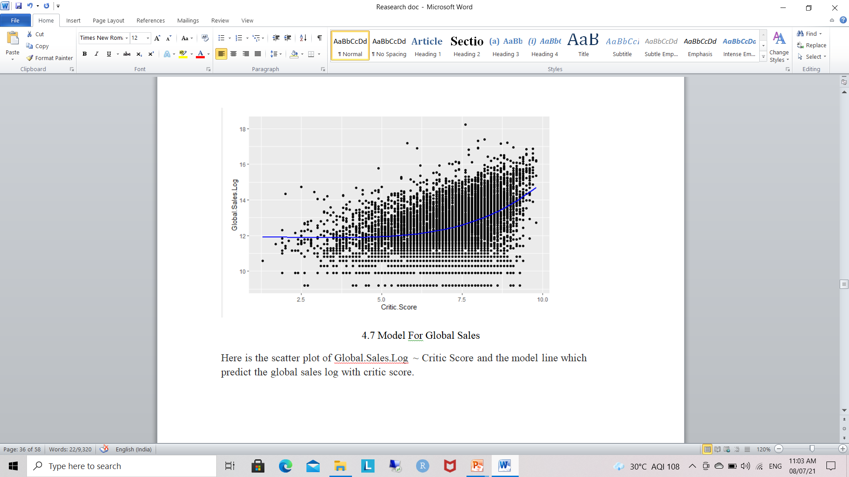
Here is the scatter plot of Global.Sales.Log ~ Critic Score and the model line which predict the global sales log with critic score.

Slide 20
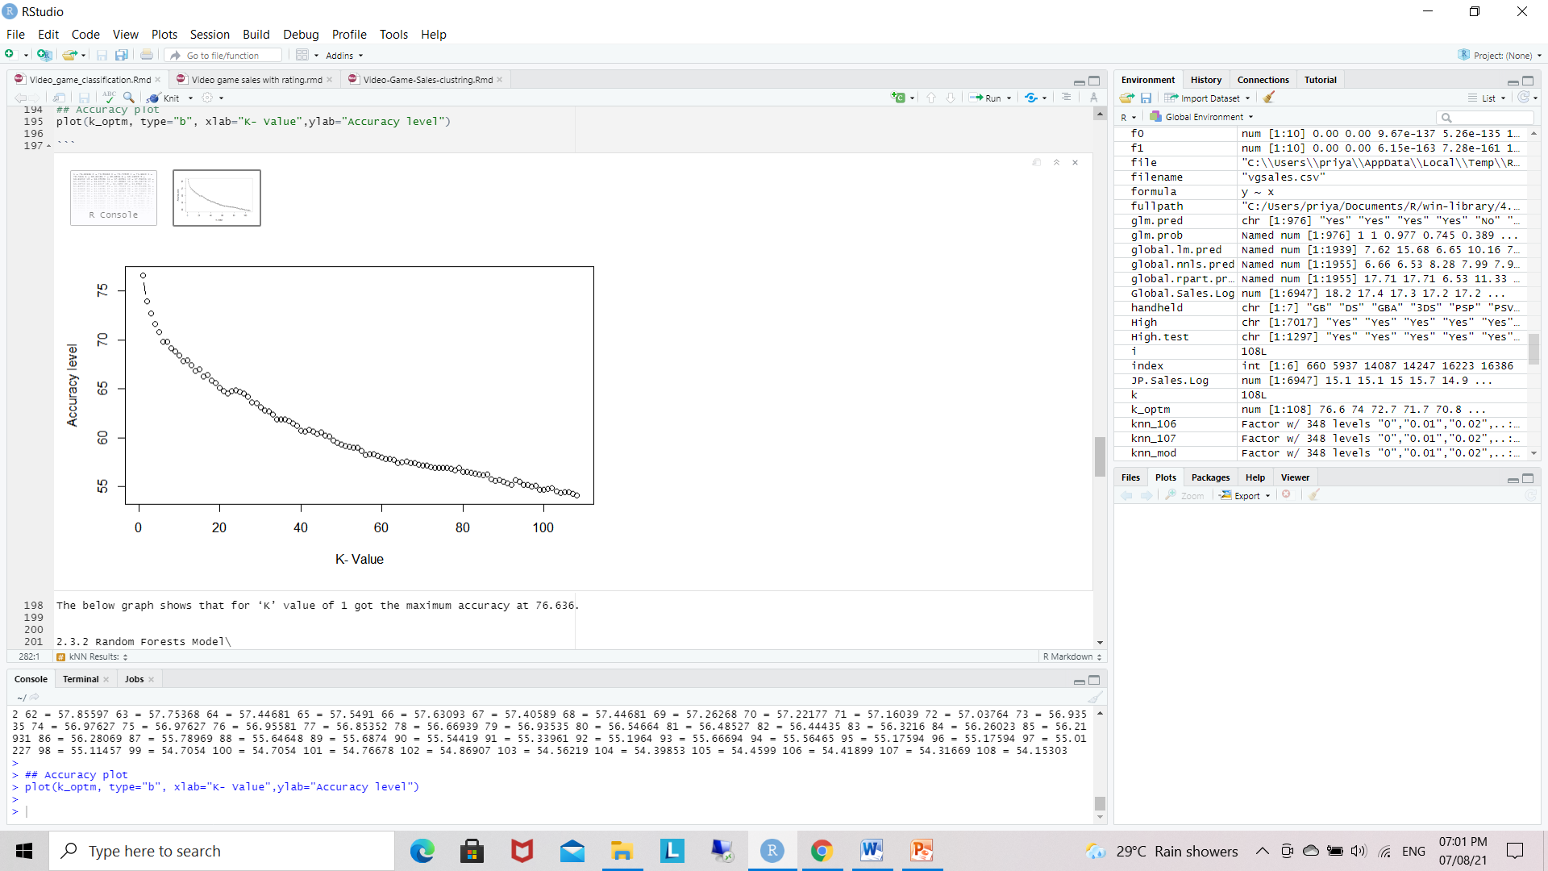
Predictive Mining
KNN-Model
The below graph shows that for ‘K’ value of 1 got the maximum accuracy at 76.636.
This accuracy for NA_SALES
In the kNN Model, we observed that training set produced starting points for the experiment with K = 106 and K = 107.
They yielded 54.50082 and 54.41899 respectively. These values were average and did not perform as well as we had hope.
We believe that data points being further apart contributed to the outcome.
K = 1 produced the most accurate result as we saw in the plot prior, which also aligned correctly with the fact that the game ranking 1st was also that one that had the highest sales. This method can be further tuned.

Slide 21
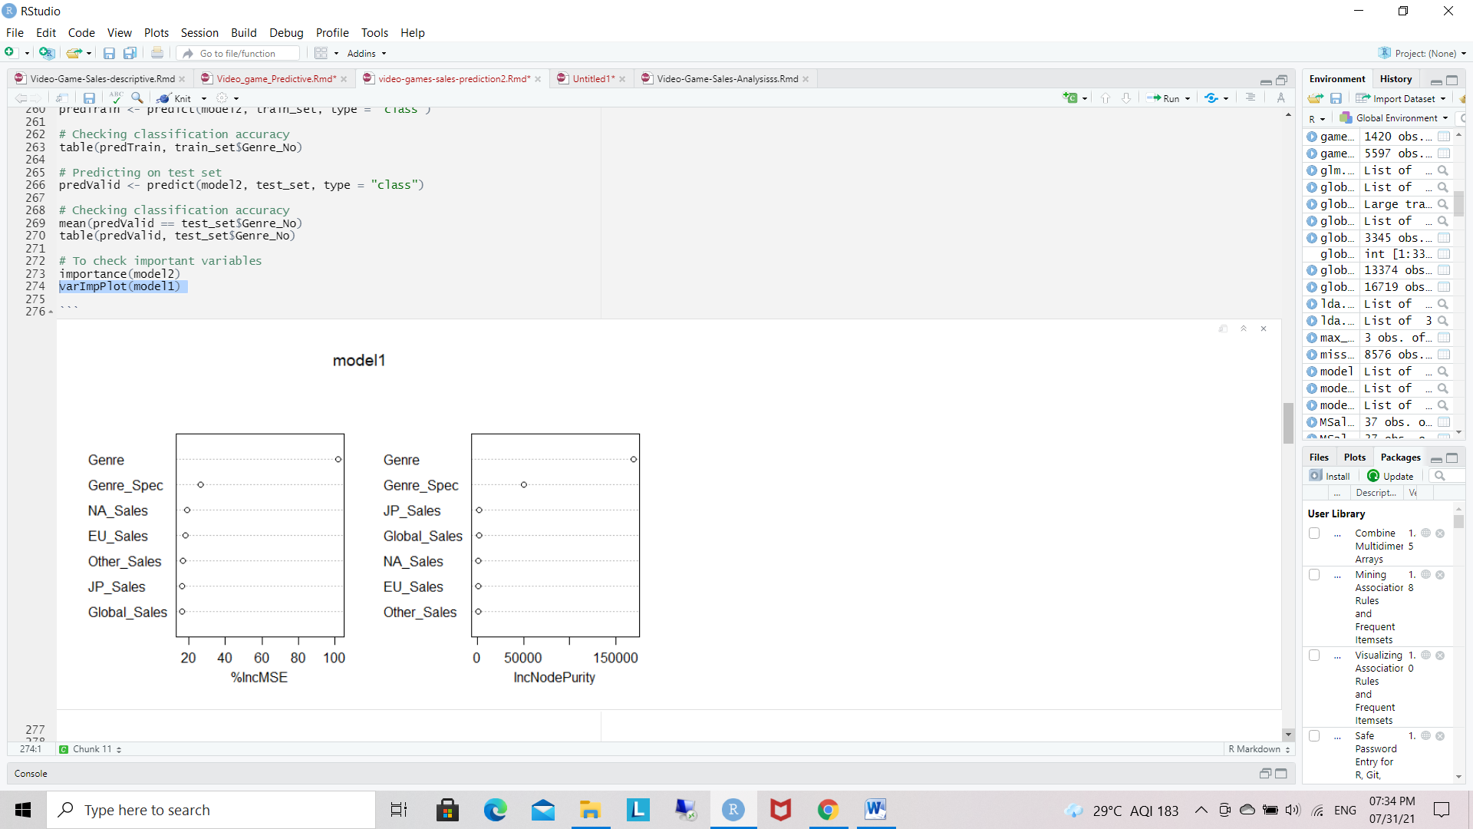
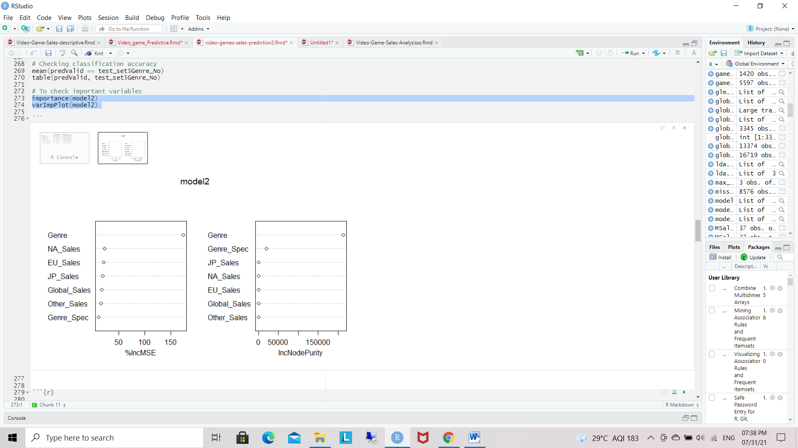
Random forests
Random Forests
Model-1:
Call: randomForest(formula = Genre_No ~ ., data = train_set, importance = TRUE, na.action = na.omit)
Type of random forest: regression
Number of trees: 500
No. of variables tried at each split: 2
Mean of squared residuals: 0.07436127
% Var explained: 99.48
Model-2:
Call: randomForest(formula = Genre_No ~ ., data = train_set, ntree = 500, mtry = 6, importance = TRUE, na.action = na.omit)
Type of random forest: regression
Number of trees: 500
No. of variables tried at each split: 6
Mean of squared residuals: 0.0002252335
% Var explained: 100

Slide 22
Output of random forests
Lastly, using Random Forests Model, we extrapolated that as the mean of squared residuals decrease then the % variance is increased.
As shown, the Genre variable importance was 191.67, the NA_Sales variable importance was 20.85 and the Genre_Spec variable importance was 10.19.
The decreasing variable importance trend seemed appropriate as we gave more weight to the Genre variable in developing this model.
The model performed as we suspected but again, can be further refined.

Slide 23
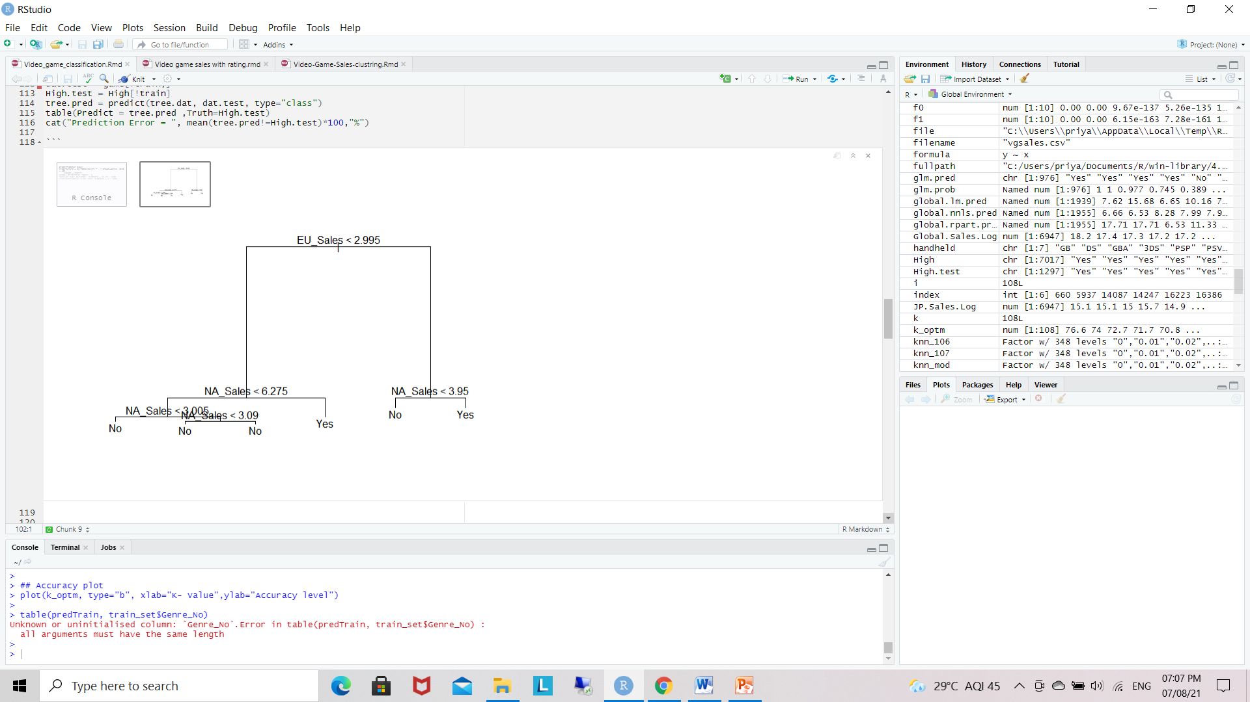
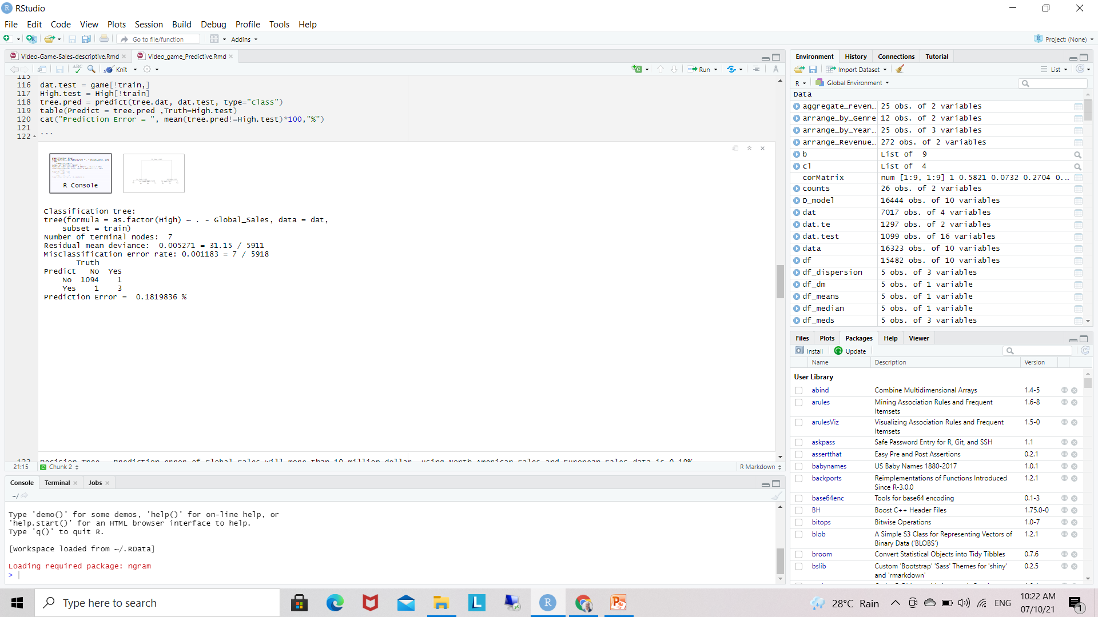
Prediction through Decision Trees
Decision Tree
Decision Tree - Prediction error of Global Sales will more than 10 million dollar, using North American Sales and European Sales data is 0.18%.

Slide 24
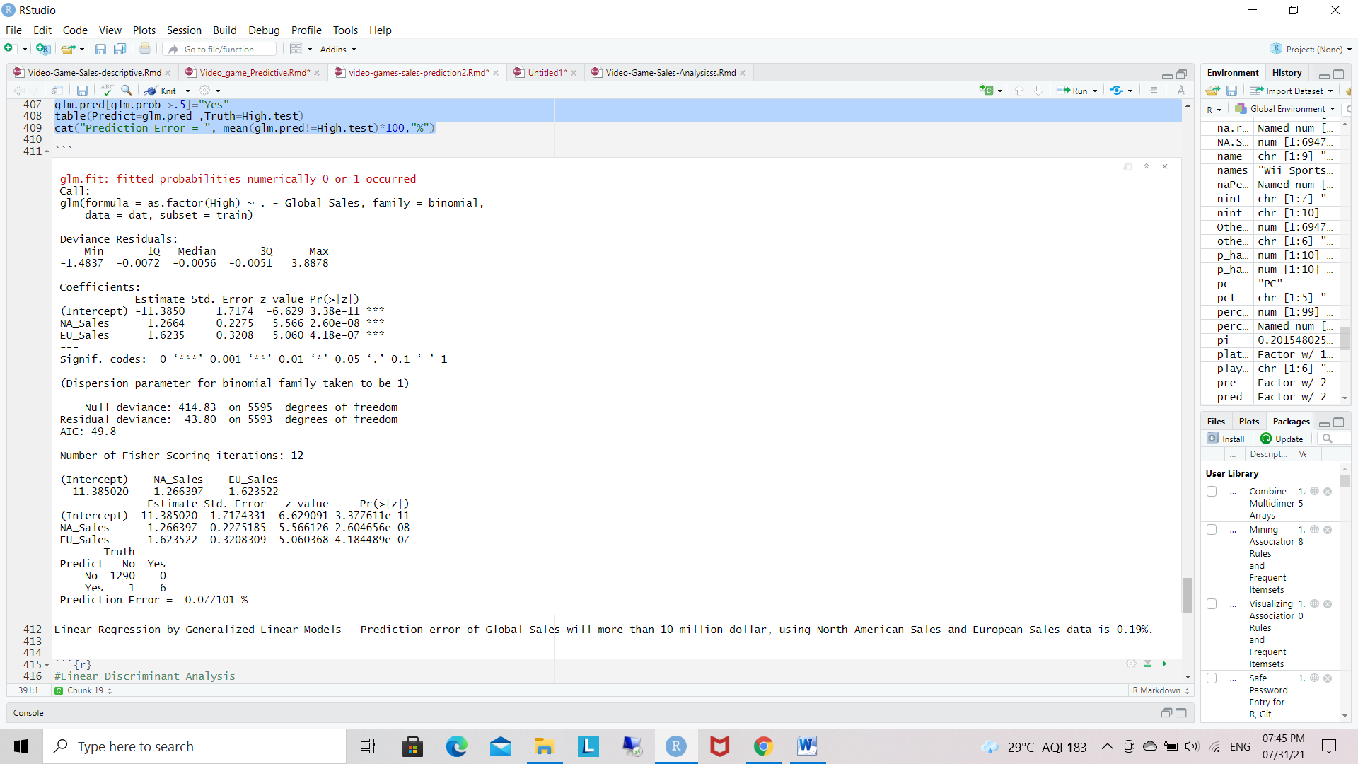
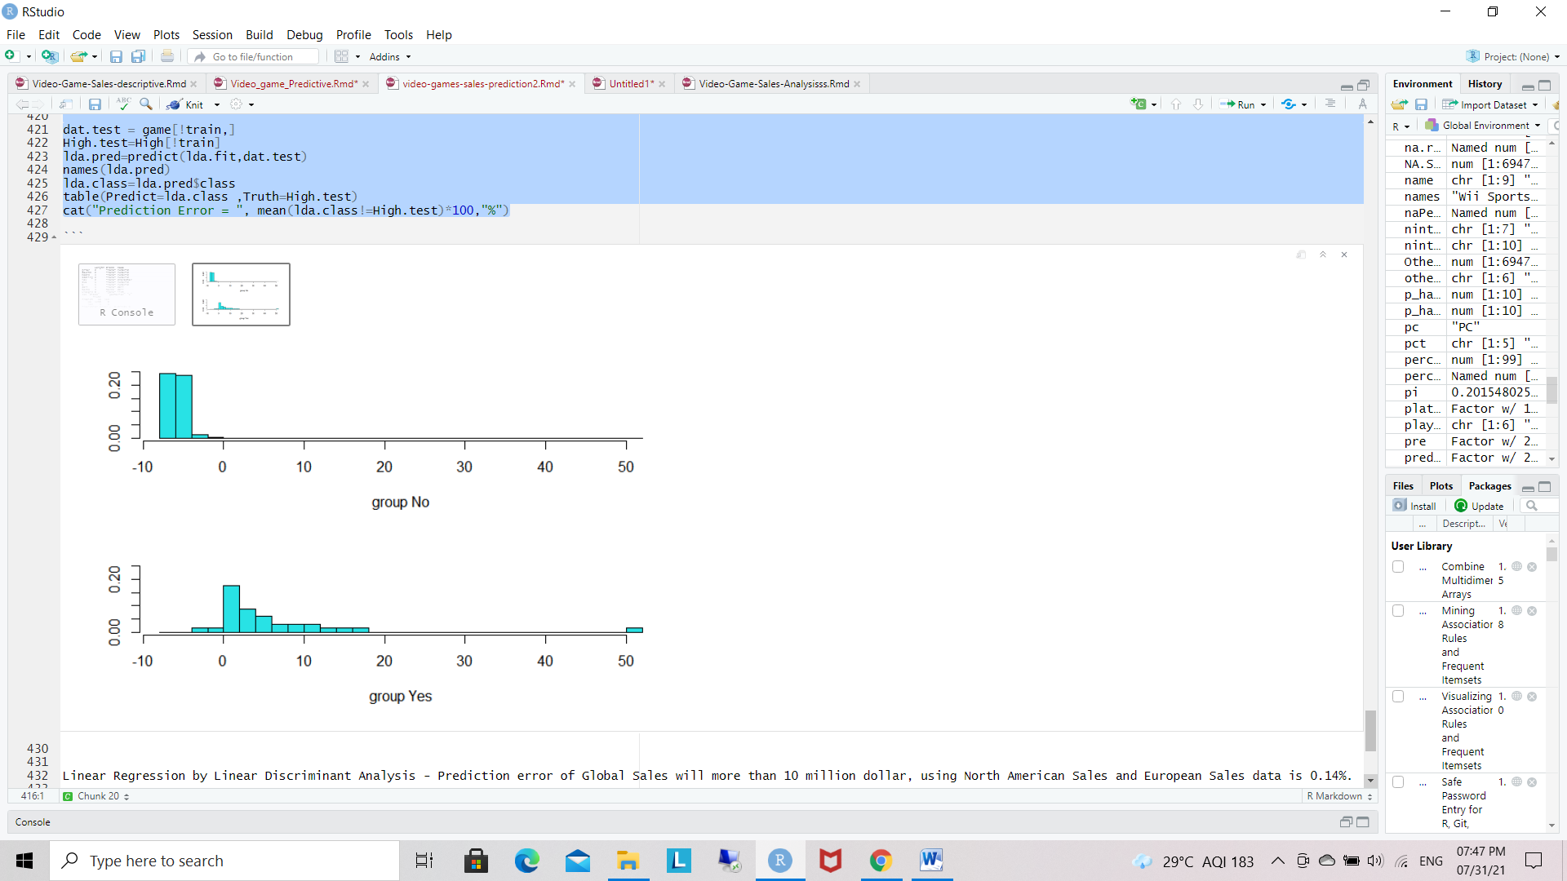
Linear Regression
Prediction through Linear Regression
Linear Discriminant Analysis
[1] "class" "posterior" "x"
Truth
Predict No Yes
No 1290 0
Yes 1 6
Prediction Error = 0.077101 %
Prediction error of Global Sales will more than 10 million dollar, using North American Sales and European Sales data is 0.19%.
Linear Regression by Linear Discriminant Analysis - Prediction error of Global Sales will more than 10 million dollar, using North American Sales and European Sales data is 0.77%.

Slide 25
Support Vector Machines
Linear classification
Prediction : Support Vector Machines
Truth
Model -1 1
-1 5558 2
1 5 32
Model Error = 0.125067 %
Truth
Predict -1 1
-1 1290 0
1 1 6
Prediction Error = 0.077101 %
SVM Linear - Prediction error of Global Sales will more than 10 million dollar, using North American Sales and European Sales data is 0.077%

Slide 26
Descriptive Conclusion
Global and regional sales are not distributed normally, while their log values are close to normal distribution. Most regional sales have the similar pattern as global sales.
There is positive correlation between critic score and user score. In total, Critic score is lower than user score. No apparent correlation was found between scores and their counts.
Critic score, user score count log, genre, rating, platform, and publisher together affect the global sales log. Critic score is the most important contributor.

Slide 27
Prediction conclusion
we contrast the predictive effects of linear regression, support vector regression, random forest and decision tree models.
We choose linear regression as the baseline model and introduce its prediction result into the result comparison.
The baseline model (linear regression)’s accuracy result, which is 77%, is not ideal.

Slide 28
Random forest, Decision tree and support vector regression are 99%, 80%, 77% respectively. It is observed that random forest model performs the best among them, with the result of 99%.
Compared with the other prediction models random forest model plays a prominent role in improving video game sales prediction accuracy in the field of large-scale product sales data.

Slide 29
Thank you

